Slide 1


HydroServer Data Access Control

Slide 2
Why
Significant feedback from academic users:
Control who can download data
How, when, and if data go from private to public
Publish papers before data are released
Track who is downloading their data
Have and use a data use/access agreement
Only expose the best or highest quality data
Integrate data organization, management, and publication
Some say that they will not publish their data using the CUAHSI HIS until they have access control

Slide 3
Four Classes of Data
Public metadata, public data (no tracking)
Public metadata, tracked public data
Public metadata, restricted data
Restricted metadata, restricted data
The system must have the ability to set access control on both data and metadata
Metadata Cataloged at HIS Central

Slide 4
Requirements
SOA and WaterOneFlow used for delivering data
An integrated system – e.g., using one database rather than a public one and a private one
Registration, authentication, and authorization of users
Access control rules set and stored on a HydroServer
Eventual support for multiple types of operations (e.g., create, read, update, delete) through web services
All data access requests will be logged on a HydroServer (can opt out)
Anticipate multiple resource types – not just time series

Slide 5
Granularity of Access Control
For time series data, permissions set at the data series level, enabling:
Controlling access to both metadata and data separately
Controlling access to data resources based on their version or quality control level
Controlling access to all series at a site
Controlling access to all series for a variable
Controlling access to all series within an ODM database

Slide 6
How We are Doing it Now
WaterOneFlow Web Service
Data Store (ODM)
Data consumer requests DataValues via GetValues()
Get DataValues from ODM
Returns DataValues
Data Access Logged
WaterML returned to consumer

Slide 7
What Needs to Change?
Requests from unauthenticated or anonymous users must be restricted to reading public resources
Requests from authenticated users must be restricted to reading public resources and whatever else they have been authorized to do

Slide 8
Proposed HydroServer Access Control
HydroServer Services
Security
Service
WaterOneFlow Web Service
Data Store (ODM)
Data consumer provides credentials
User
Authentication
Security service returns a token
Data consumer calls GetValues using the token
The token is evaluated to see if the consumer is authentic and authorized
True (Authorized), False (Not Authorized), or Error (Token Not Found)
User Authorization and
Data Access
True – Get DataValues from the data store
Returns DataValues
Data Access Logged
Data returned to consumer

Slide 9
User Identities
Preferably reusable across HydroServers (single sign-on)
Preferably unique across HydroServers
Credentials: Email Address(UserName), Password
Profile:
First Name
Last Name
Organization
Email address
Password

Slide 10
Tokens
Specific to one user on one HydroServer
Lifetime is specified by a HydroServer Administrator
Globally Unique Identifier (GUID)
Stored as:
HydroServerUserID
GUID
CreationDate
ExpirationDate

Slide 11
Identified Design Processes
Administrator creates user
Client requests user creation
Admin manages user creation requests
Client authenticates user (gets token from a server)
Administrator authorizes a user
Client requests authorization for a user
Administrator manages authorization requests
Client gets metadata for a user (harvesters)
Client gets data for a user

Slide 12
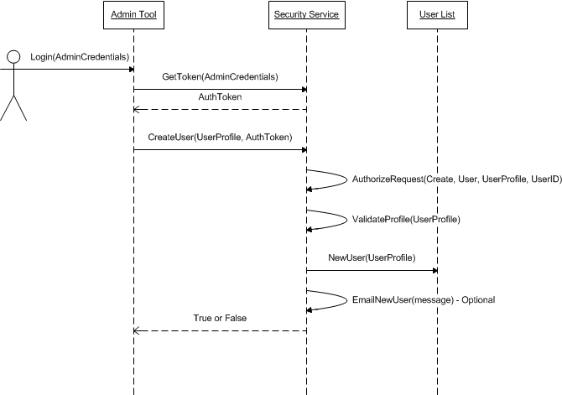
Example – Administrator Creates User

Slide 13
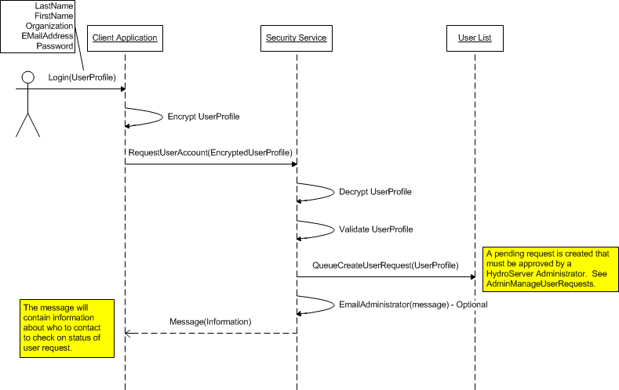
Example – Client Requests User Creation

Slide 14
Implications for HydroServer
Required New Components
Security Web Service
AuthorizeRequest, CreateUser, GetAuthInfo, GetResourceInfo, GetToken, GetUsers, ModifyUser, RequestUserAccount, RequestAuthorization, SetAccess
Access control database
Data resource list
User lists (Pending/Approved)
Token list
Access permissions lists (Pending/Granted)
Logs?
Web page for requesting user accounts and authorization to get specific data
Admin tool for managing users, resources, and permissions

Slide 15
Implications for HydroServer
New security service and access control database must be set up and maintained
WaterOneFlow web services:
Upgrade to enable working through the security service
Metadata methods should return information about access control for series
Two options for WaterOneFlow services:
Configured to work through the security service and requiring tokens
Configured as public – entire contents of database are public
Time Series Analyst, Map Application, and HydroServer Website will have to be modified to use access control

Slide 16
Implications for HIS Central
Harvesters will essentially be unauthenticated users (no tokens)
Harvester metadata calls (e.g., GetSites, GetSiteInfo) will return only public metadata
Catalog should probably keep information about whether the data are restricted
Would require that WaterOneFlow GetSiteInfo calls return this information

Slide 17
Implication for Clients (HydroDesktop)
Will have to enable users to specify credentials
Will have to manage:
Encryption of credentials
Passing of encrypted credentials and tokens
Will have to handle error messages returned by services
What to do when you get an Error.NotAuthorized

Slide 18
Questions We Still Have
What information do we need about users for a profile?
Management of users and credentials – create a centralized user list or not?
Should we bother with tokens or just encrypt credentials and send with every call as the “token?”
Tokens can expire but credentials don’t
Should we separate the authentication and authorization APIs?

